Slide 1
Diabetes Readmission Phase I
Paul Songdechakraiwut

Slide 2
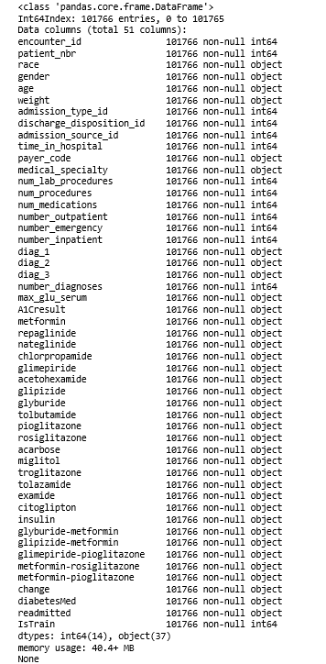
Diabetes Dataset
Column Type

Slide 3
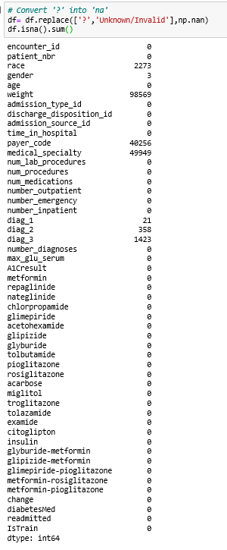
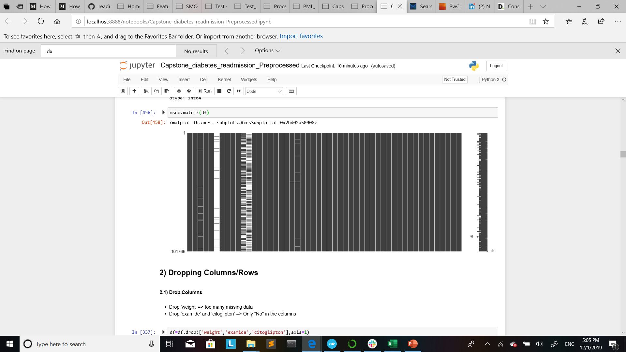
Investigating missing Data
Missing data

Slide 4
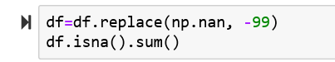
Dropping Columns/rows & Imputation
Dropping
Imputation
Drop Columns
Drop 'weight' => too many missing data
Drop 'examide' and 'citoglipton' => Only "No" in the columns
Drop Rows¶
Drop rows on 'discharge_disposition_id' =11 (Expire)
: The patient passed away --> No way to come back.

Slide 5
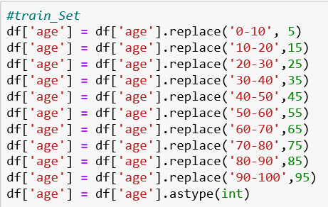
Grouping
‘age’
‘admission_id’
Group:
1,2,7 to 1
5,6,8 to 5

Slide 6
Grouping
‘'discharge_disposition_id'’
‘'admission_source_id’
Group:
Discharge/Transfer: 1,2,3,4,5,6,8,10,15,16,17,22,23,24,27,28,29,30 to 1
Hospice : 13,14 to 13
No data: 18,25,26 to 18
Expire : 19,20,21 to 19
AMA : 7
expect to return: 12
admit as an inpatient: 9
Group:
Referral : 1,2,3 to 1
Transfer: 4,5,6,10,22,25,26 to 4
Delivery: 11,12 to 11
baby admission: 13,14 to 13
no data: 9,15,17,20,21 to 9
Emergency: 7
Court: 8
Readmission: 19
‘A1Cresult '’
‘max_glu_serum '’
Group:
- >7 & <8 = 1
Norm = 0
None = -99
Group:
>200 &>300 = 1
Norm = 0
None = -99

Slide 7
Grouping
‘diag_1’ / ‘diag_2’ / ‘diag_3
‘Change’
Group:
‘Ch’ = 1
‘No = 0
Group:
(390<= X< 460 )& (X = 785) = 1
(460<= X< 520 )& (X = 786) = 2
(520<= X< 580 )& (X = 787) = 3
(X=250) = 4
(800 <= X <1000) = 5
(710<= X <740) = 6
(580 <= X < 680)& (X= 788) = 7
(140<= X <240) = 8
V & E & 0 = 0
‘diabetesMed’
Group:
‘Yes’ = 1
‘No’ = 0
‘readmitted’
Group:
‘>30’ = 1
<30 & no= 0

Slide 8
Features Creation (Medication)
‘numchange’
‘nummed’
No & ‘steady’ = 0
‘up’ & ‘down’ = 1
Sum all of those
No = 0
‘steady’ &‘up’ & ‘down’ = 1
Sum all of those

